Slide 1
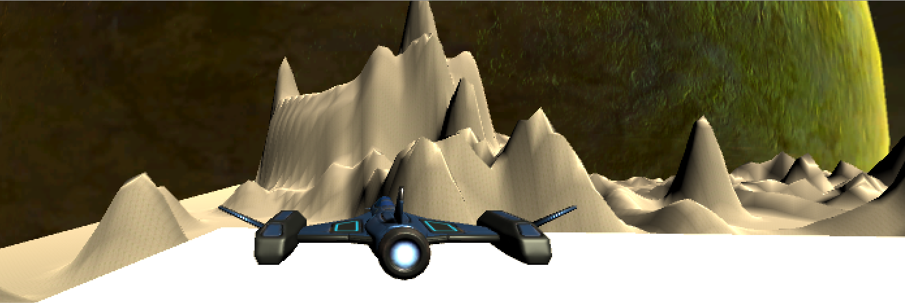
Psychological Effects of DDA in Single Player Casual Shooting Games
Made By:
[Group 11]
Leung Sze Hiu
Ng Kok Kiat
Lee Ming Hei
Lee Hoi Yin
Sweta DAS
Notes:
Psychological Effects
Of DDA
In Single-player
Casual Shooting Games

Slide 2
Motive
Related Work
Game Dev & Design
Limitations
Background of our project
Key Contributions
Different difficulty systems implemented
Our Game- Tool for research
Suggestion for future works

Slide 3

Motive
Project Background

Slide 4
Motive
Dynamic Difficulty Adjustments (DDA)
Matching the player to the suitable challenge (Rield & Zook, 2013)
Effectively address the different abilities of its players
→ Achieve immersion
First person shooting genres where demand for skills is higher (Glavin & Madden, 2015)
Static game elements: Not flexible
To maintain game challenge
Outcomes are predictable by repetitive gameplay

Slide 5
Key Contributions
This research is going to implement DDA into our game
→ To test effects of DDA on a single-player shooting game
By adjusting the player level during the gameplay
Based on the player’s performance
Maintain Game Challenge
→ Characteristics for maximising DDA effect in the game

Slide 6
Related Works
Difficulty systems of other shooting games

Slide 7

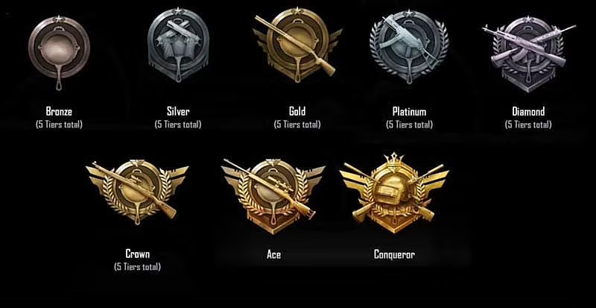
Battle royale: PUBG
Rank system (Other player)
Impossible for single player games.

Slide 8

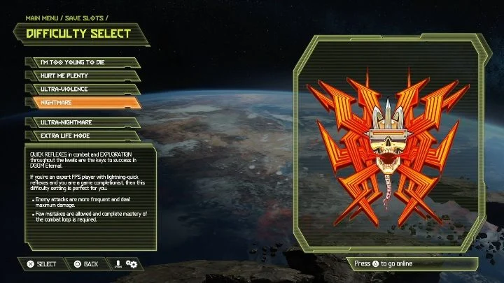
FPS: Doom Eternal
Predefined difficulty modes
Unique names
User might not know how to/ might not choose a suitable level
Disrupt player’s immersion in game when changing difficulty level

Slide 9


RPG/Shooting: Half-Life
TPS: Max Payne 2
DDA across storyline
Prolonged gameplay due to storyline
Not suitable for casual gaming

Slide 10
Game Design and Development
Space Shooter

Slide 11
Concepts used from our research
Psychological factors
Setting up targets for each round of gameplay
Immediate feedback system
Upgrading mechanism
Al factors
DDA
Waypoints

Slide 12
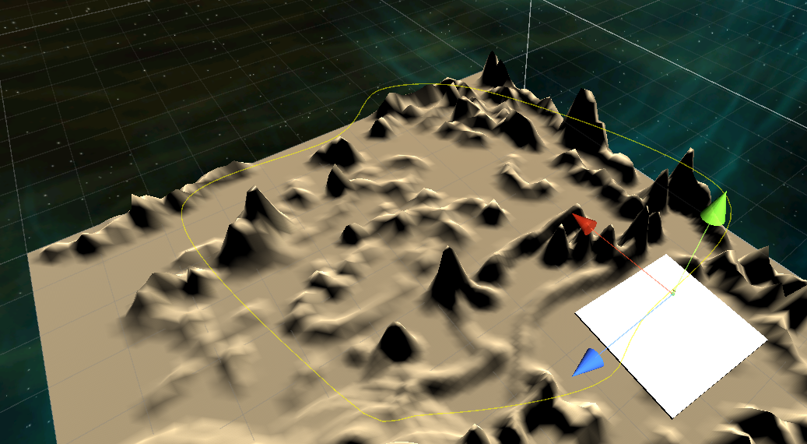
AI tools
Waypoints- Player moves on a fixed path defined by connection between waypoints
DDA- Dynamic Difficulty Adjustment
Judged by DDA- health/score of the player
Self adjusting difficulty in the game by observing player’s interaction
More the health/score of the player, more the difficulty increases

Slide 13
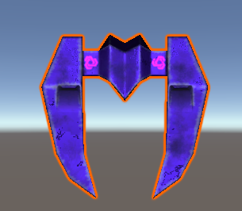
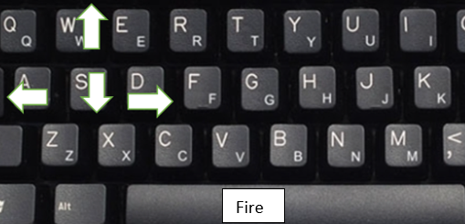
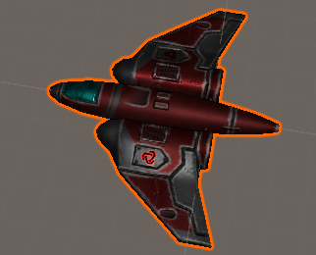
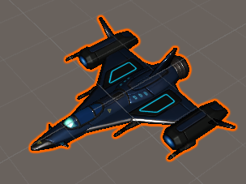
Game characters and navigations
Health=6
Purple spaceship- Stronger enemy
Controls- Up(W key), Down(S key), Right(D key), Left(A key), Shoot bullets(Spacebar)
Health=3
Health=100
Red spaceship- Weaker enemy
Player Spaceship- Controlled By Player
Notes:
Shooting game- Spaceship on rails
Enemies have different health levels
More dangerous enemy, more it health level, more the points upon hitting it
Spawning enemies as per health/score of player

Slide 14
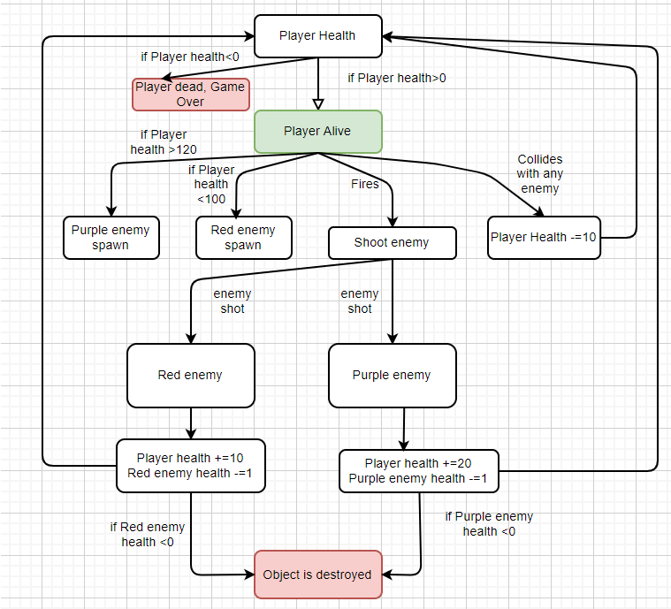
Flow and Difficulty concepts
Notes:
Shooting game- Spaceship on rails
Enemies have different health levels
More dangerous enemy, more it health level, more the points upon hitting it
Spawning enemies as per health/score of player
Explain DDA, few parameters, DDA monitirs health, what change will happen
Implementation of DDA
Threshhold approh to increase elvele. When paramters mnitored omthhings trihggered
Paramters-

Slide 15
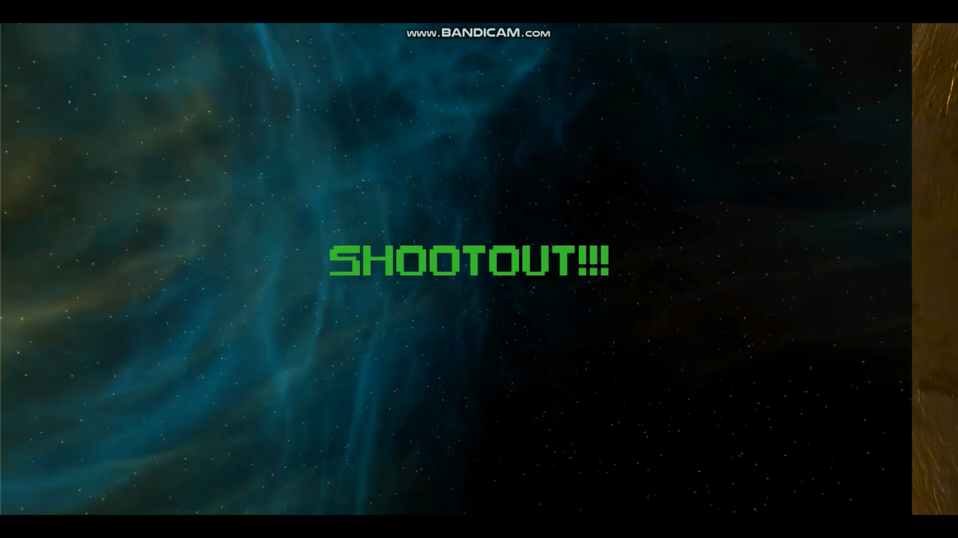
GamePlay Video

Slide 16
Direction of Survey
- What do we want to find out?
Players experience and ability to estimate a difficulty that matches their skill
A better way to implement DDA in a shooting game
Effects of DDA to players immersion

Slide 17

Limitations

Slide 18
Current Limitations
Transparency of the difficulty level
A few levels is provided
The player cannot exit or pause the game
The player cannot choose his speed.

Slide 19

Future Works

Slide 20
Future Work
More relevant parameters for adjustment of DDA
E.g. Hit rate
Show statistics of the player performance
Can indicate how many times a player changes his difficulty level
Transparent Difficulty
Letting the players know what level they are facing
Weapon / Equipment Upgrading
Create more maps or stages
Include more AI behaviors and more type of enemies

Slide 21

Questions and Answers

Slide 22

Thank You

